Slide 1
Rotary Club of Plymouth September 15, 2023

Slide 2
This

Slide 3
Welcome to rotary!
Meditation –
Broadcaster –
Introduction of Guests

Slide 4
Lunch signup
Sign up is important
Salad Options
If you can’t sign up electronically, call or email Marie
734-453-6879 x4
Marie.morrow@pcuw.org
Maurice Salad
Caesar with or w/o chicken
Greek with or w/o chicken
Spinach with or w/o chicken
Mediterranean

Slide 5
It’s Lunch Time
Please invite our guests to go first
Meeting will resume in about 20 minutes

Slide 6
September Birthdays
Carolyn Butler 07
John Hamerink 09
Jacqueline George 22
Bryce Bilinski 23
Marie Morrow 26

Slide 7
Link for Tix:
https://checkout.square.site/buy/V6YFC3NCZCIKFOQMFU3UPHMK

Slide 8
Plymouth Ghosts Cemetery Walk All 8 Characters are Charter Members or Wives
https://www.eventbrite.com/e/plymouth-ghosts-cemetery-walk-tickets-694191975887?aff=oddtdtcreator
Tickets are $20 in advance and $25 the day of, if there are any left. Eventbrite charges a small transaction fee.

Slide 9
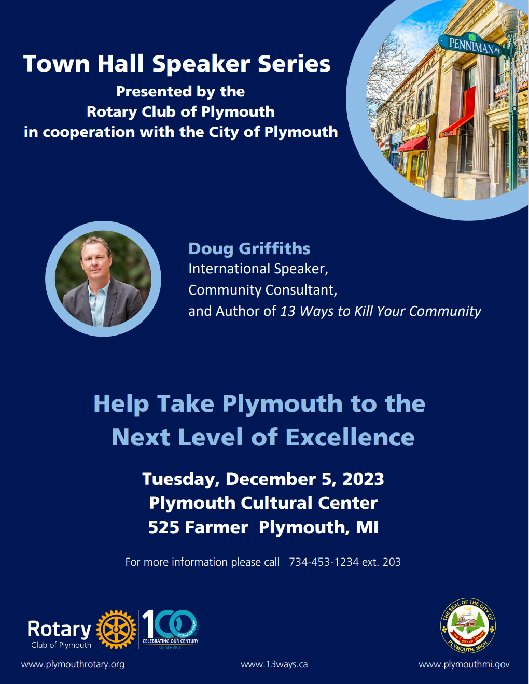

Slide 13
City of Plymouth Mayor and Plymouth Rotarian Nick Moroz

Slide 15
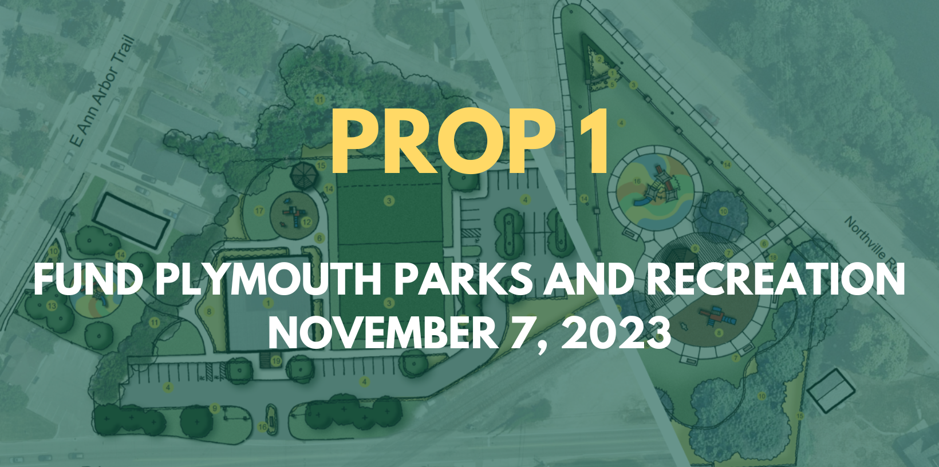

Slide 16
What is this ballot proposal?

Slide 17
Actual Ballot Language
Shall Section 8.5 of the Charter of the City of Plymouth, Wayne County, Michigan, be amended to permit the levy by the City of a new additional ad valorem property tax in an amount not to exceed one and three-quarters (1.75) mills, for 12 years, from 2024 through 2035, to provide funds to the City to acquire, construct, improve, furnish, operate and maintain parks and recreation facilities? It is estimated that 1.75 mills would raise approximately $1,275,955 when first levied in 2024.
(YES OR NO)

Slide 18
Quick facts…If passed
Raise $1.275 M per year dedicated to parks and recreation projects in the city
The city is losing access to fields
The 2021 Citizen Survey showed 68% of residents say P&R is VERY IMPORTANT
The funds would be used to:
Update and improve all neighborhood parks and facilities and operations
Acquire property and develop new parks and facilities to meet our growing needs
Offer major discounts for residents on registration fees
The funds would allow the city to access more grant opportunities
1.75 mills would be levied per year for 12 years
A $250K home would pay roughly $218 per year

Slide 19
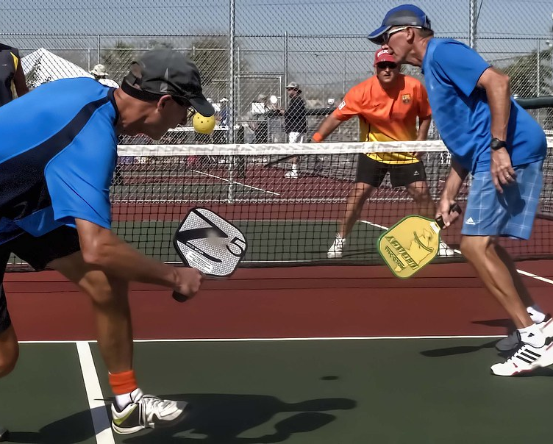
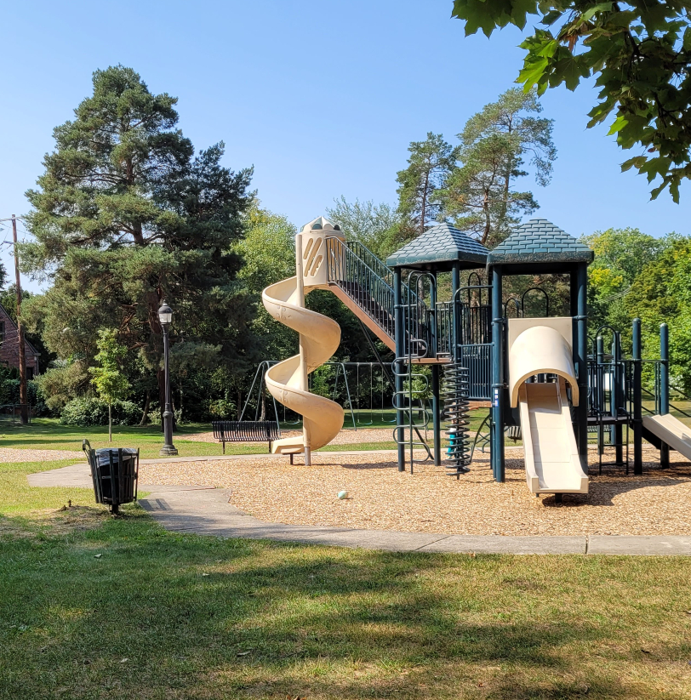
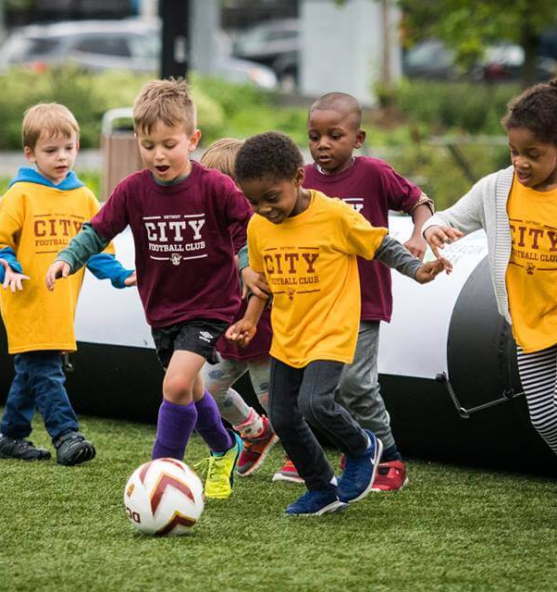
Why? Quality of life in Plymouth

Slide 21
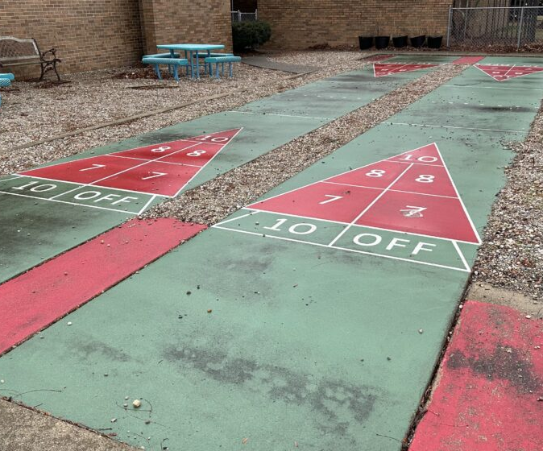
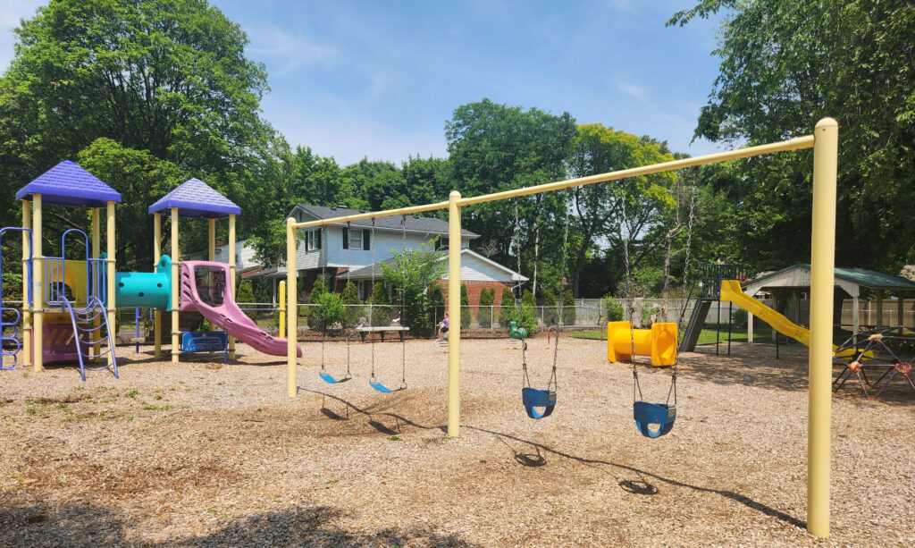
The need to invest in capital projects
The typical Parks and Recreation Agency (population less than 20K)
$650K budgeted over the next 5 years for capital projects
City of Plymouth Parks and Recreation (just less than 10K)
$0 budgeted for capital projects - No available funding

Slide 22
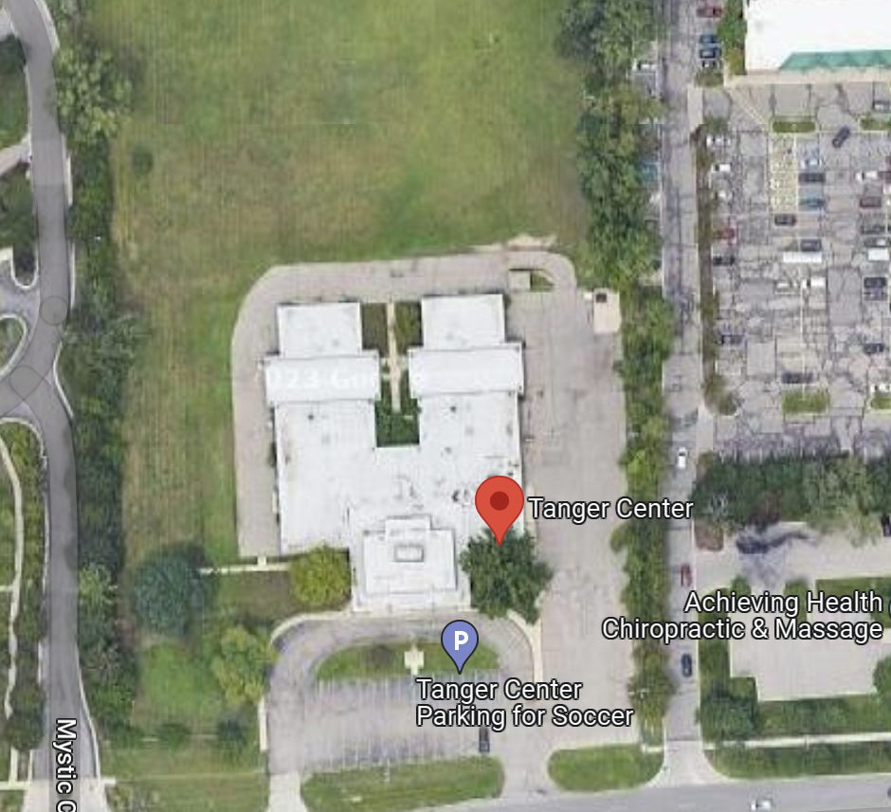
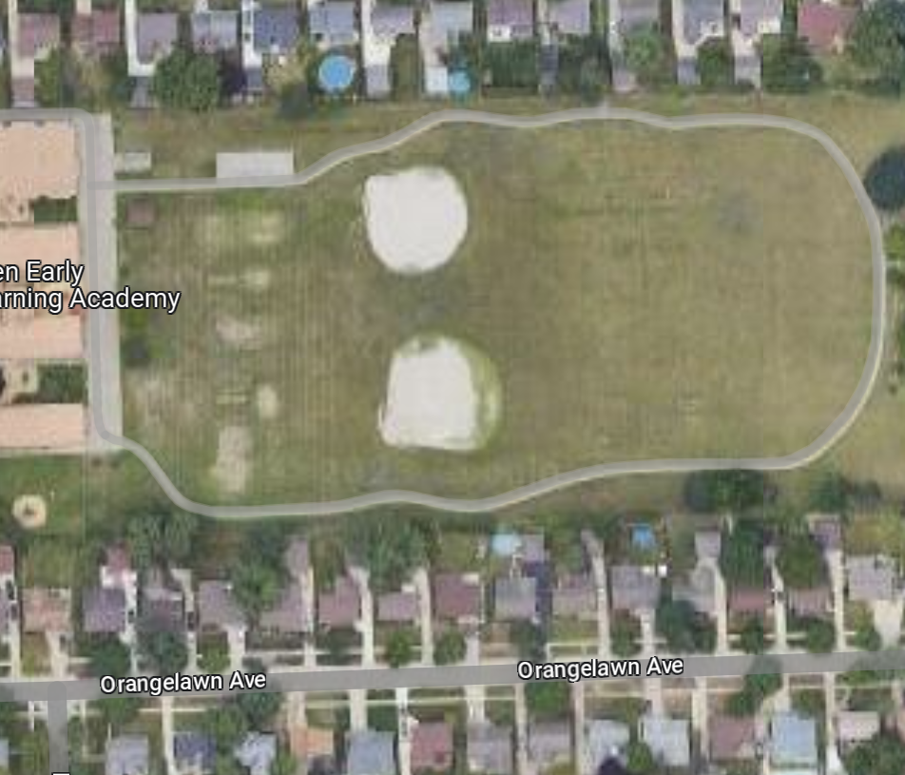
Losing access to athletic fields means fewer programs

Slide 23
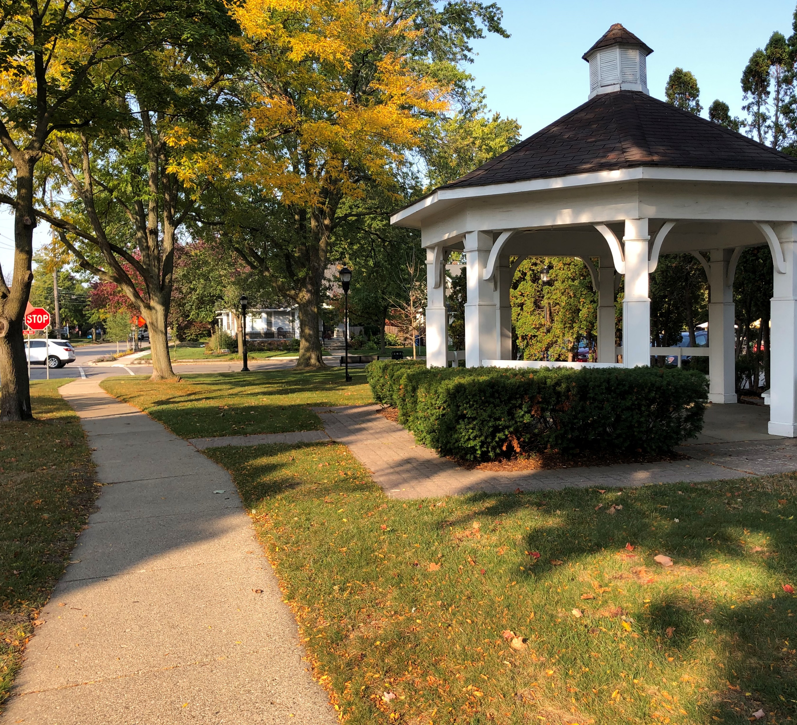
What is the goal of this proposal?

Slide 24
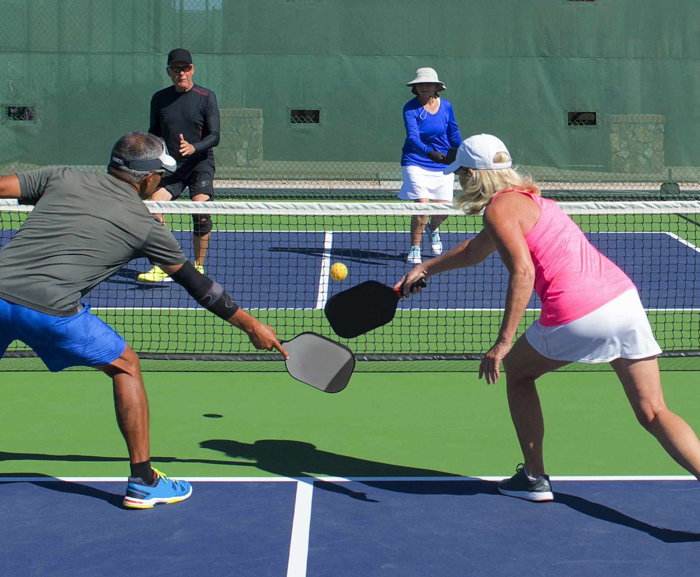
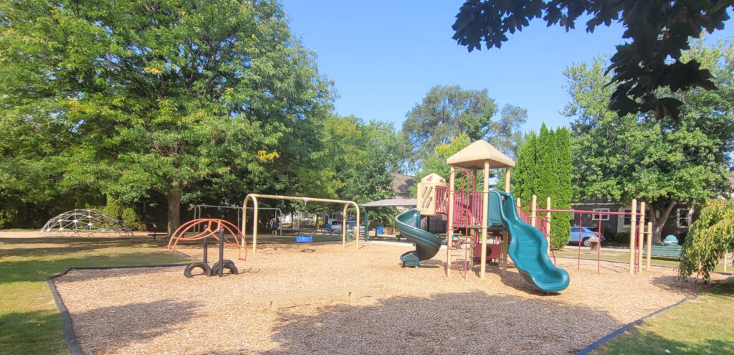
Update our parks, facilities, and operations Develop new parks and facilities Offer discounts to residents

Slide 25
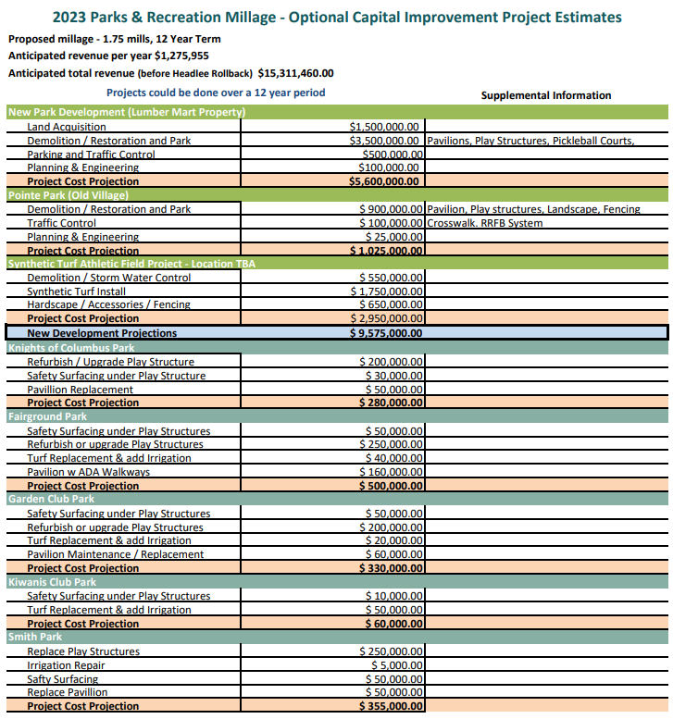
Implement a comprehensive plan

Slide 26
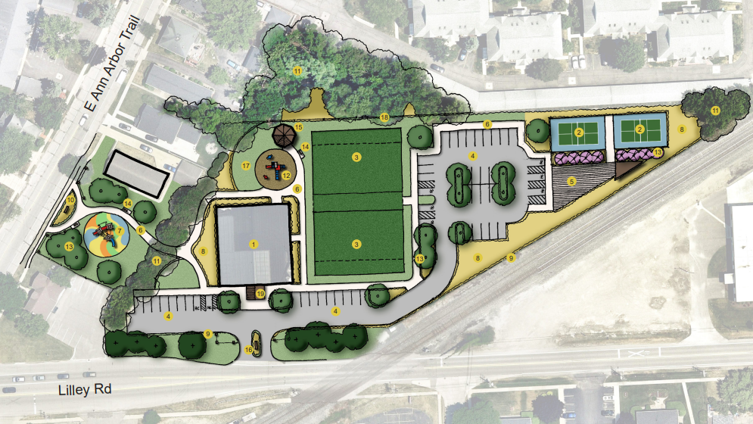
An opportunity to meet our needs

Slide 27
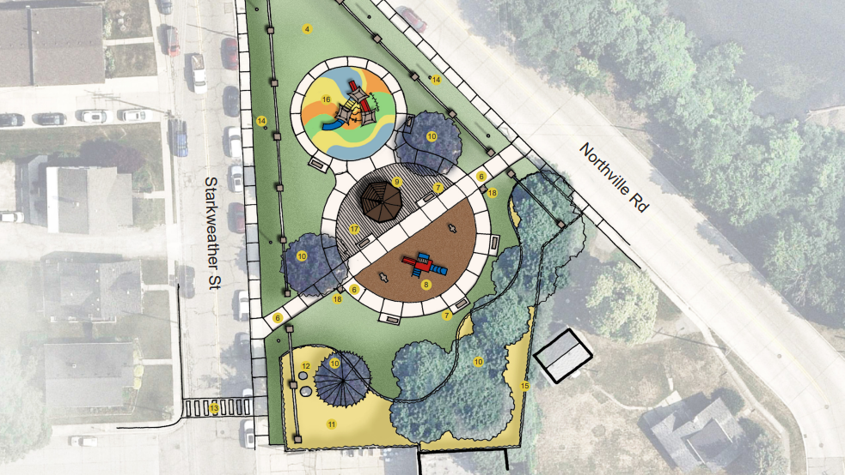
An opportunity to meet our needs

Slide 28
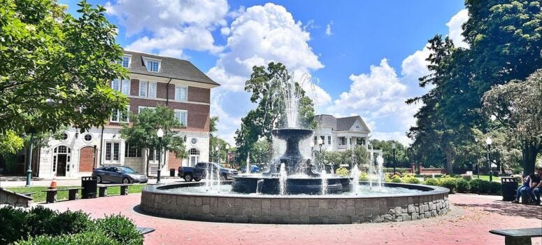
What are the economic benefits?

Slide 29
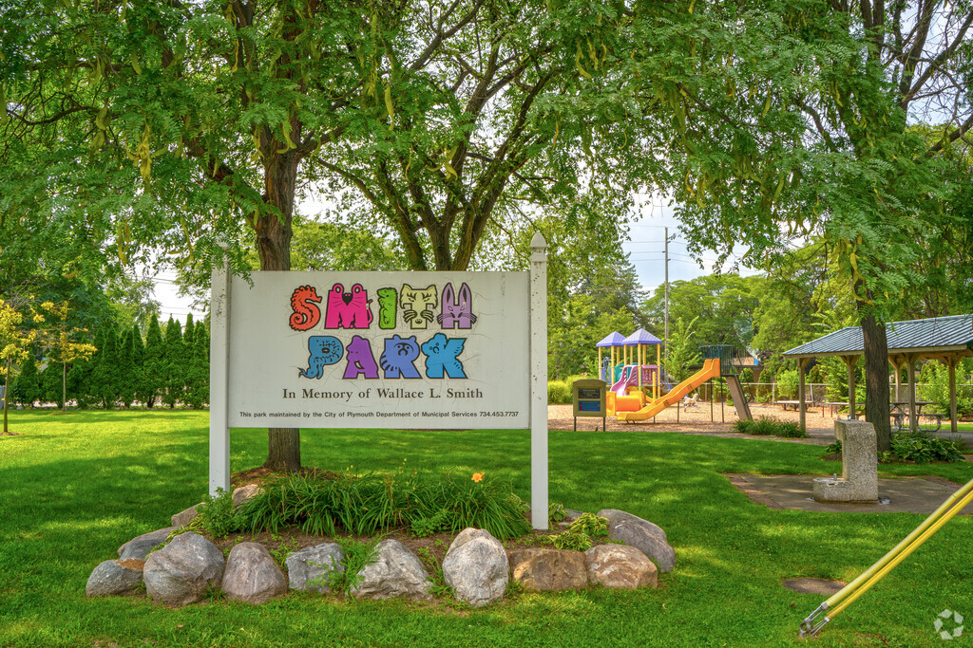
Plymouth property values
The National Recreation and Park Association estimates an 8-10% increase in value of property that is located close to a local park

Slide 30
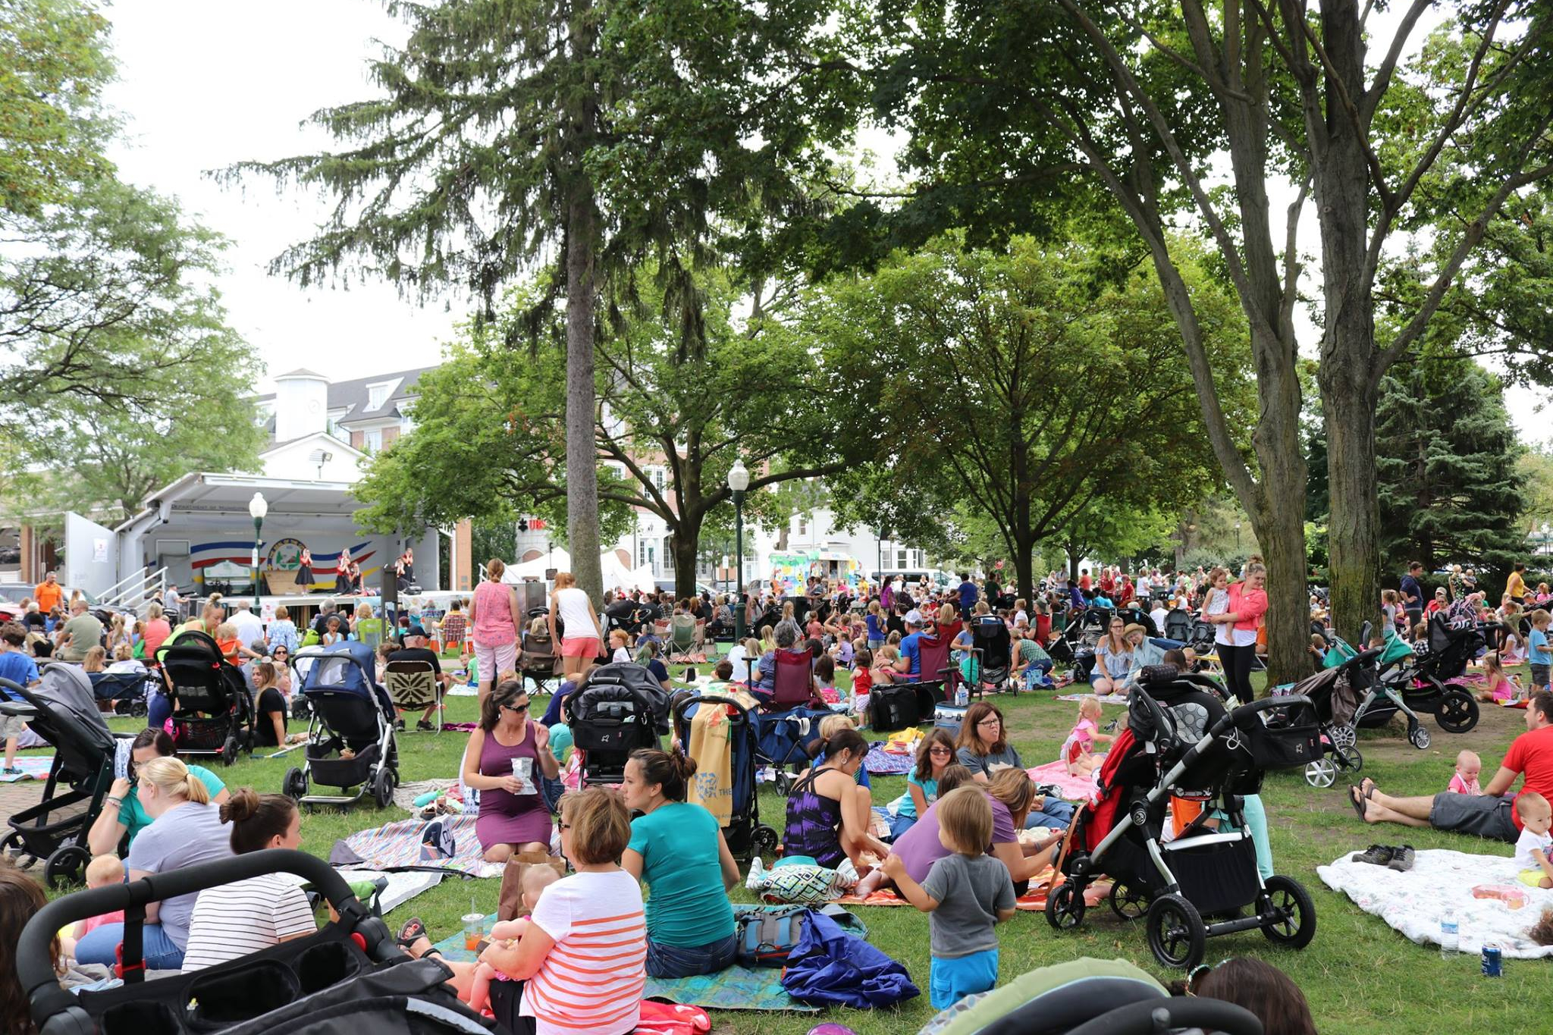
Income from out-of-town park visitor spending
Plymouth’s parks, such as Kellogg Park, are key economic drivers bringing visitors from far and wide to enjoy all that our community has to offer. They also act as staging sites for events and gatherings.

Slide 31
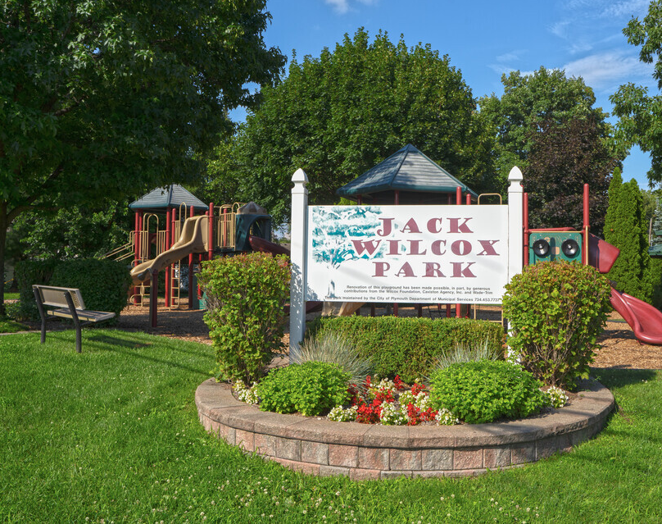
Parks can dramatically reduce the cost of managing stormwater
Parks mitigate this by absorbing and slowing runoff, acting as reservoirs.

Slide 32
What was the process to put this on the ballot?
2018 - the City Commission adopts joint recreation master plan with Twp.
November 2021 - the City Commission receives survey results
January 2023 – City Commission, Administration, and public create strategic plan for city
2023 – City Commission asks Administration to identify space for Parks and Recreation
July 2023 – City Commission adopted ballot language
August 2023 – Governor and Attorney General approve language

Slide 33
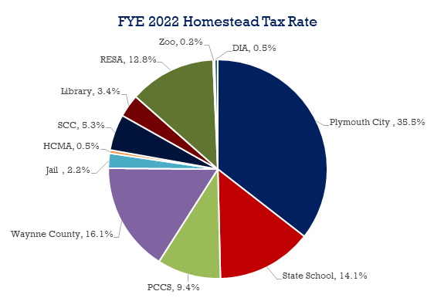
Why aren’t the taxes I pay enough to cover the cost for parks and recreation?

Slide 34
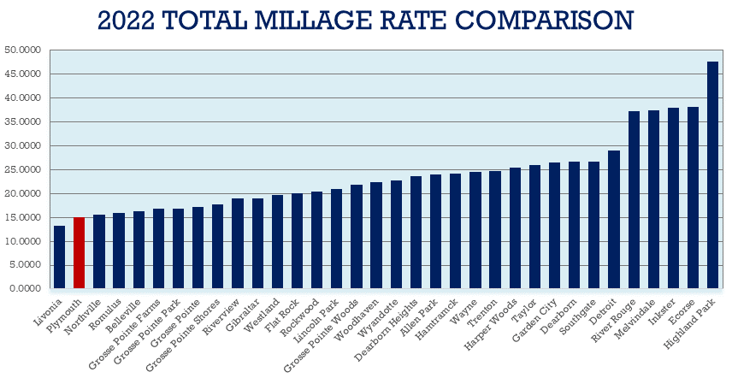
How do our taxes compare to other communities?

Slide 35
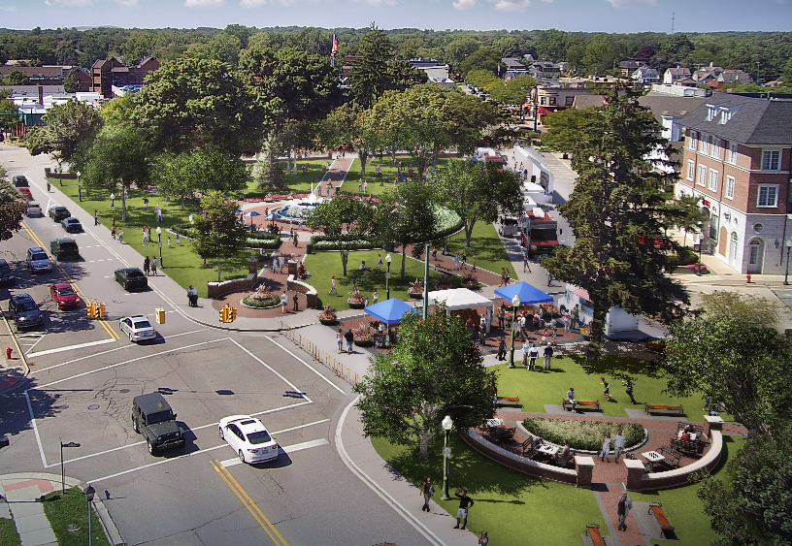
What will this cost me?
1.75 per $1,000 taxable value of the household, taxable value is roughly half the market value of your home
A $250K home would pay roughly $218 per year
If that home had two people participating in 1 season of soccer each, it would roughly break even after the expected discounts

Slide 37
50/50 DRAWING
And the winner is …..?
This Photo by Unknown Author is licensed under CC BY

